Slide 1
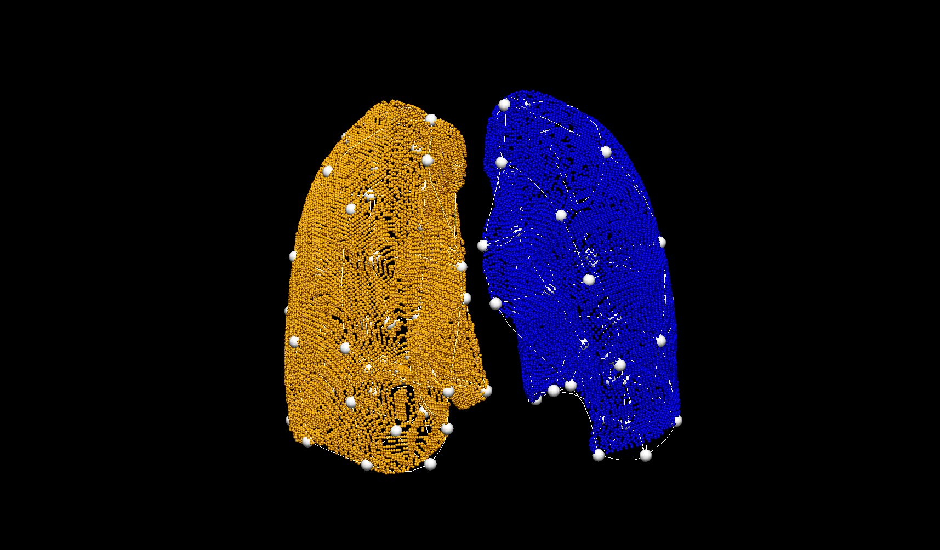
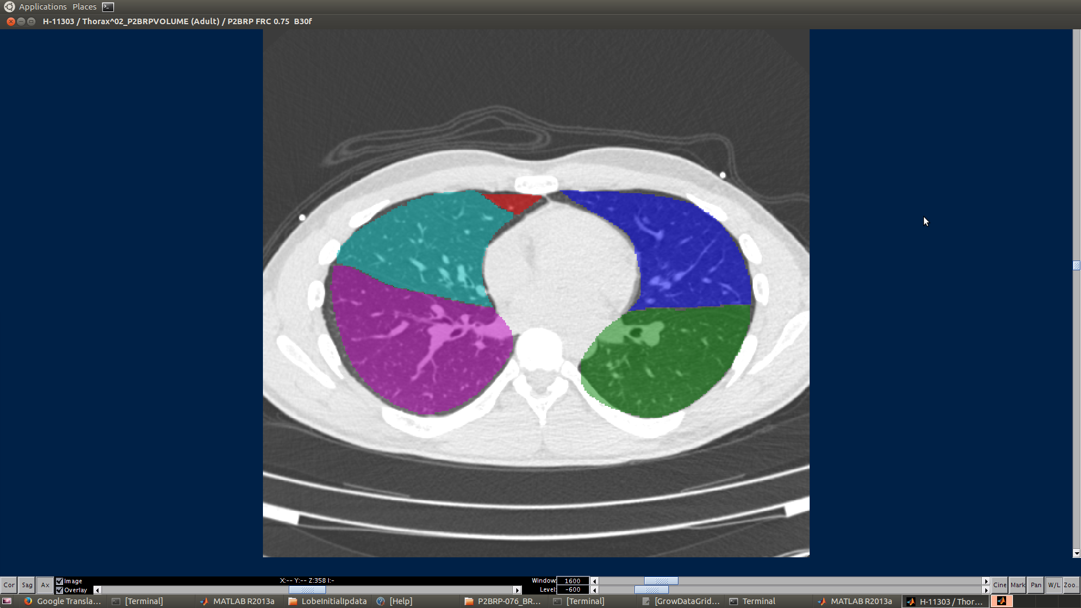
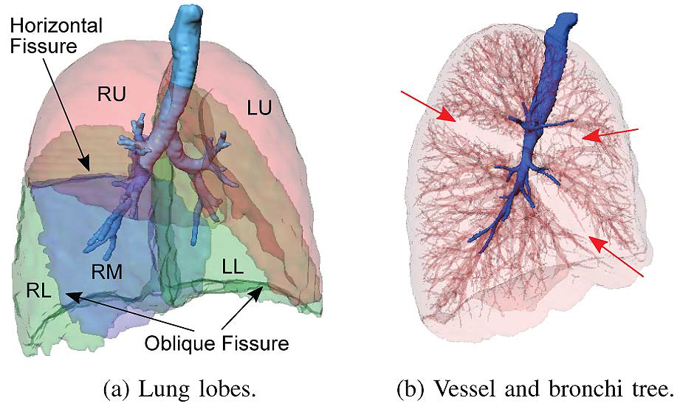
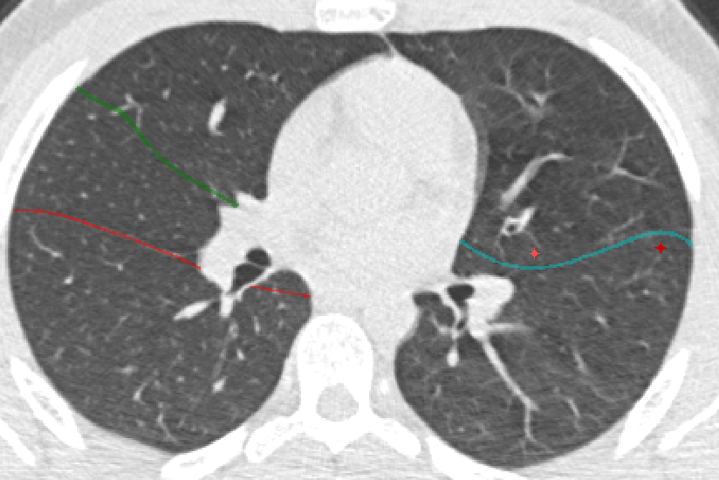

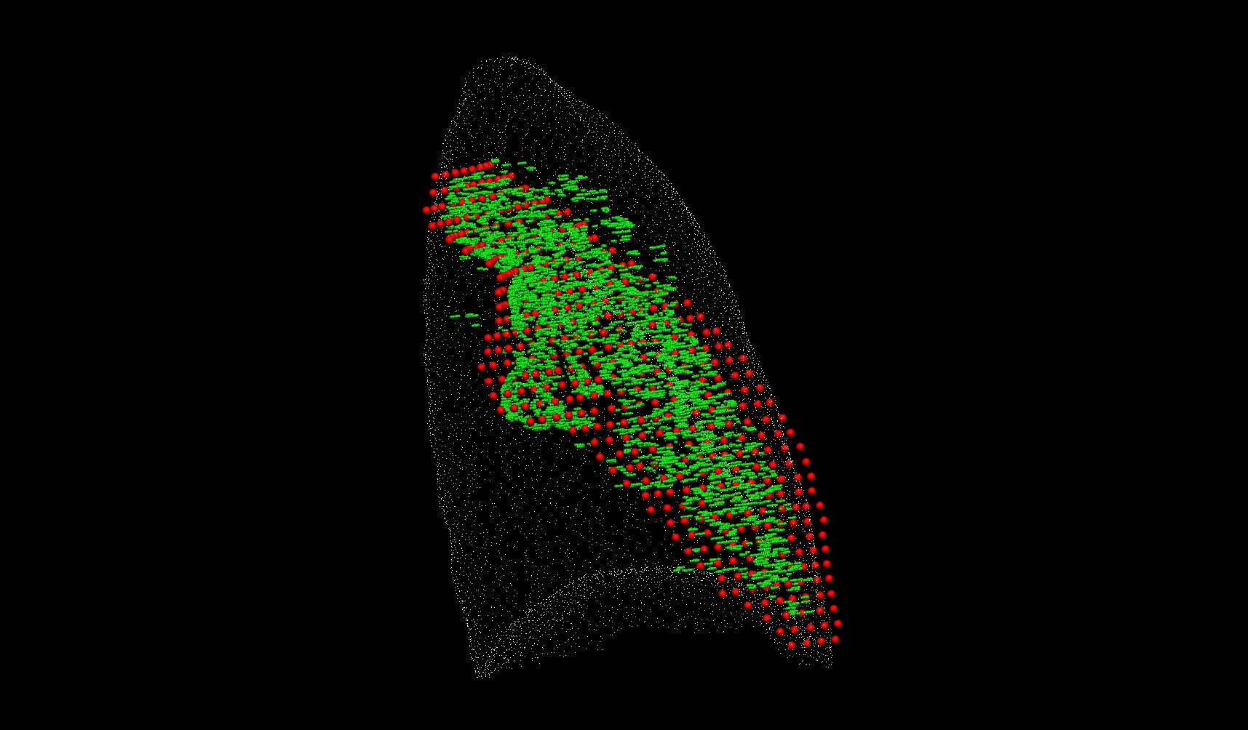

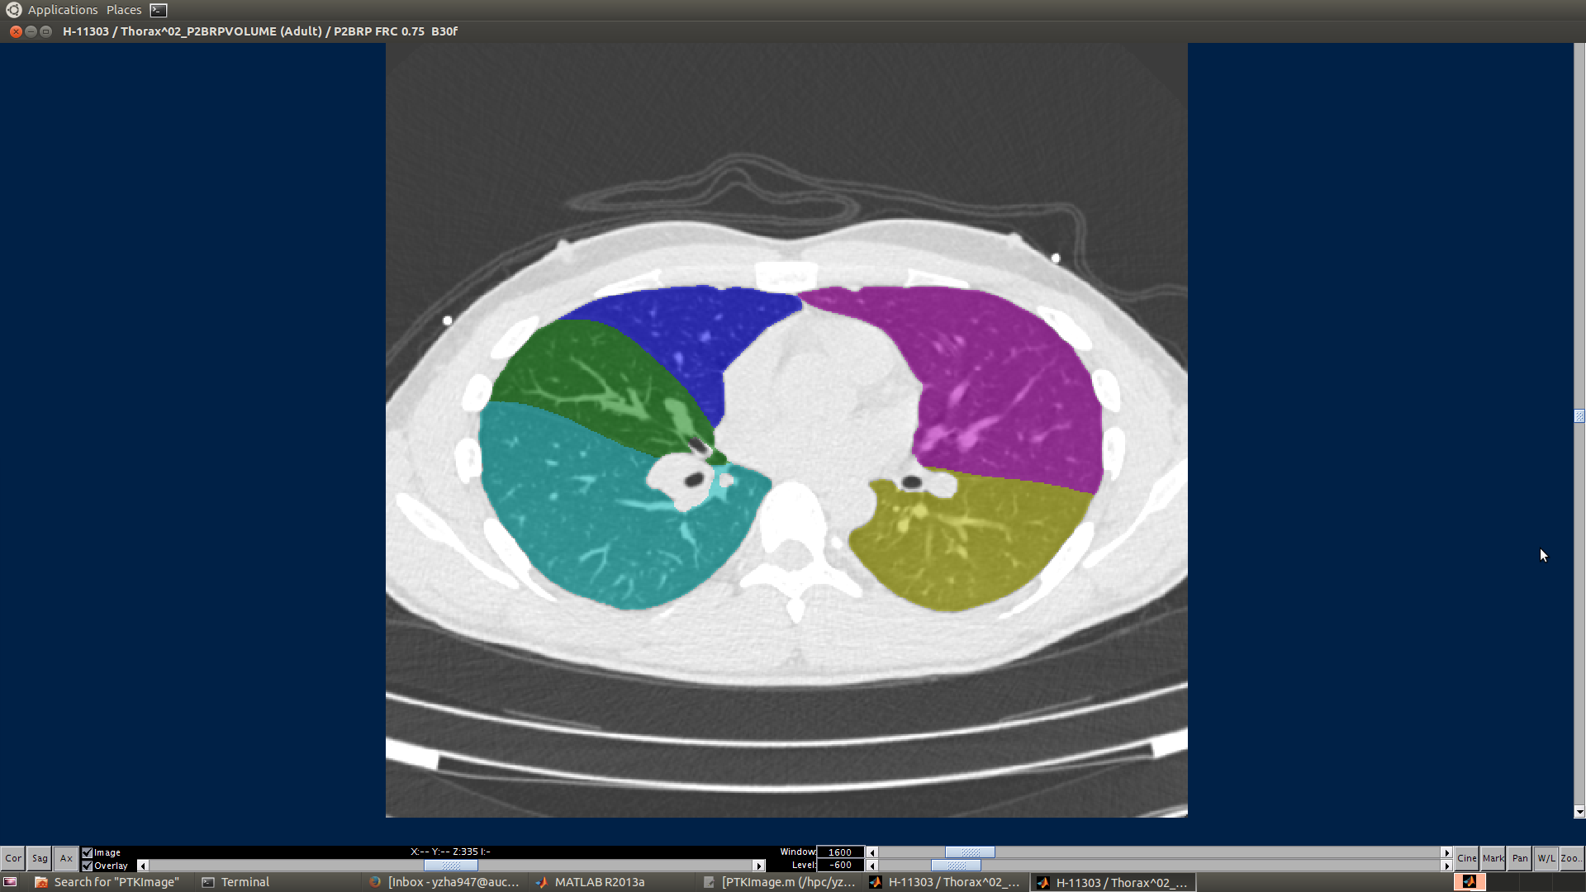
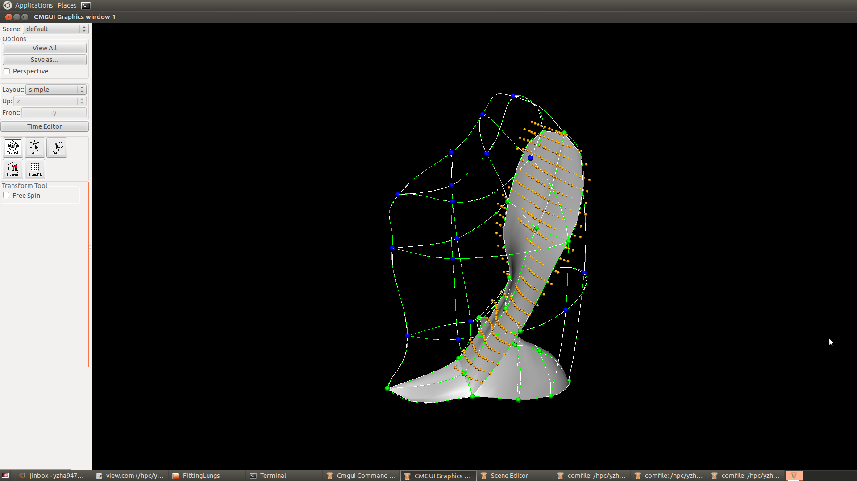
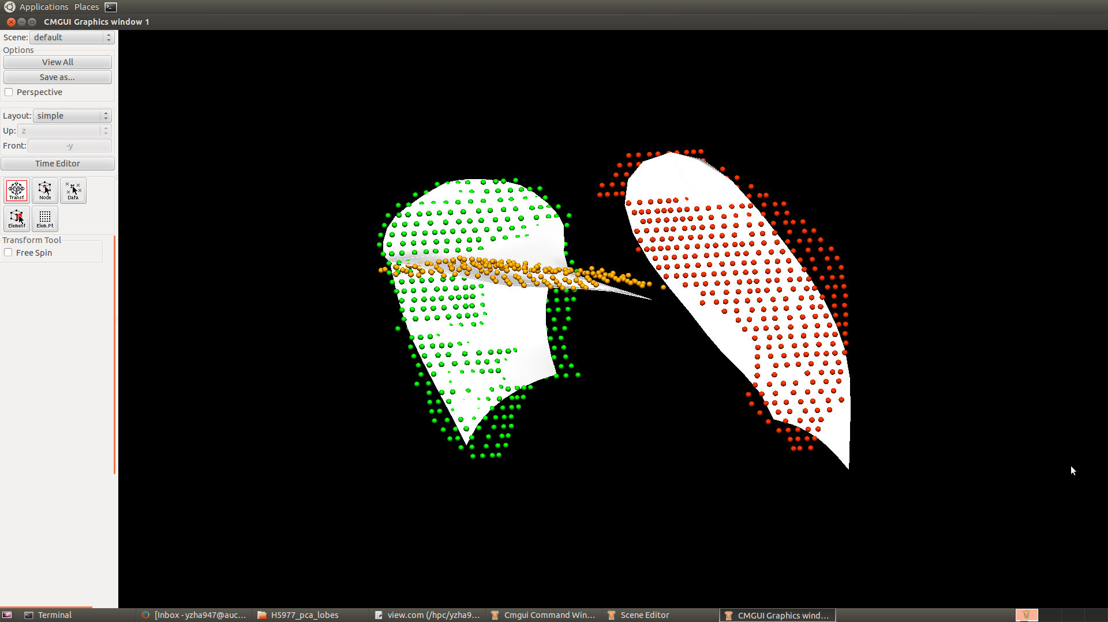
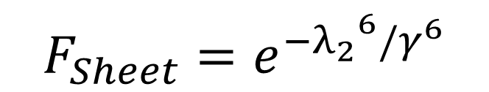


Automatic pulmonary lobe segmentation from CT scans
Yuwen Zhang, Alys Clark, Habib Baluwala, Merryn Tawhai, Auckland Bioengineering Institute, The University of Auckland, New Zealand
Background
The human lung is divided into five distinct anatomic compartments called lobes. The current lobe segmentation methods usually have some limitations: 1. heavily rely on anatomical knowledge. 2. largely ignore individual variability. 3. sensitive to noise. 4. lead to reconstruction of artifacts.
Hessian matrix fissure detection based on PCA model
Compute the fissureness probability of each voxel based on Hessian matrix
Fissure Detection
Fissure surface fitting
Deform PCA model using lung surface data from PTK
Improved user-interactive correct mode of PTK
$$F_{Structure}=(−λ_{3})e^{{−(λ_{3}−α)}^{6}/β^{6}}$$
$$S_{Fissure}=F_{Sturcture}×F_{Sheet}$$
We plan to segment pulmonary lobes using a PCA-based model. With the help of the average model, we will be able to get rid of the dependence on the segmentation of other anatomic structures such as airway trees which are usually failed to be detected for pathological lungs. In addition, this method allows us to use a successful TLC segmentation to assist with FRC segmentation.
$$F_{Sheet}=e^{−{λ_{2}}^{6}/γ^{6}}$$
2D connected component analysis
Lung surface data generated from PTK
Deformed PCA mesh shown in PTK
Remove the non-lung region
Renderings of the anatomy of the lungs. This shows the human lungs subdivided into the right upper (RU), right middle (RM), right lower (RL), left upper (LU), and left lower (LL) lobe.
3D connected component eigenvector based analysis
Fissure sampling result
Manual-selected landmarks for fissure correction
Fissure lines after correction
PCA Weight Mapping Transformation
Training lobe mesh
PCA lung average model
Get mapping weights
Input
PCA lobe average model
Fitted lobe mesh of a new subject
Deformed PCA lobe model
Red points: manual result
Green points:
automatic result
Lobe segmentation result shown in PTK
Deformed PCA model can provide an approximate location of the fissures
CMISS fissure surface fitting
Lobe segmentation workflow with PTK(Pulmonary Toolkit)
Summary
Manual fissure digitising and lobe fitting of about 20 subjects
Implement a initial PCA-based lobe segmentation method (mainly on healthy subjects)
Complete the basic user-interface workflow and interface
PTK Lung segmentation
Lung surface data point (.exdata)
Lung surface fitting
PCA Weight mapping deformation
Improvement of correct mode
Lobe segmentation result
Hessian matrix + local fissure points searching + connected component analysis
Matrix labels as lobes + add new plugin
Future work
Improve the lobe segmentation method, especially for detection of the right horizontal fissure
Test the lobe segmentation algorithm on more subjects, especially abnormal subjects
(a)
(b)
PCA weight mapping transformation. (a) Left fitted lobe mesh. (b) Deformed PCA fissure mesh compared with manually digitising fissure data.

